Slide 1
NBAC TSC Slides 25 September 2025 Meeting
Paul Wormeli
Kamran Atri
Thomas Krul

Slide 2
25 September 2025 NBAC TSC Agenda
1:00 NBAC Chair (s) Opening Remarks – Mr. Kamran Atri, Thomas Krul & Paul Wormeli
Paul Wormeli elected PGB Chair
Soliciting volunteers for NBAC secretary
Outreach Plan for Domain Stewards
Virtual & Face-to-Face for DC Domains, schedule TBD
NDR 6.0 and NIEM Model Version 6.0 Statements of Use Approved 11 Sep 25
NDR 6.0 and NIEM Model Version 6.0 Vote to approve as Candidate OASIS Standards starts:
Next Steps: 60 Day public Review
8 October 25 NIEMOpen Leadership Meeting
9 October Forensics Domain Townhall
13 November 25 Reveal Summit
1:15 NIEM Management Office (NMO) Update – Mr. Steve Sullivan
sullivan_stephen@bah.com
1:25 NTAC Update – Scott Renner, Brad Bolliger
1:30 Questions/Final Remarks

Slide 3


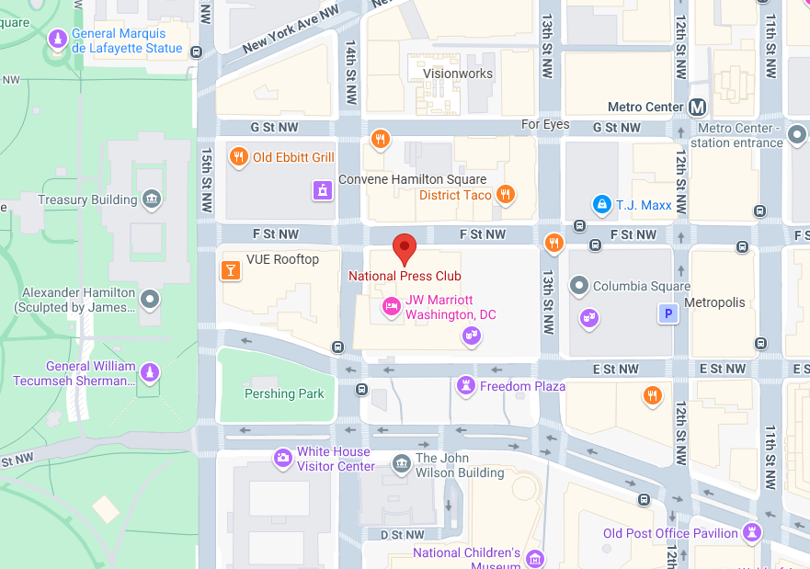
NIEMOpen Leadership Meeting National Press Club & Virtual
Date/time: 8 October 2025, ~ 9 AM – 4 PM
Venue: National Press Club & Virtual
529 14th St NW, Washington, DC 20045
“DRAFT” Agenda
Link for NBAC & NTAC Plenary Sessions: TBD
Link for AM & PM Joint Sessions & Q&A:
OASIS NIEM is inviting you to a scheduled Zoom meeting. Join Zoom Meeting https://us06web.zoom.us/j/8016452879?pwd=a3hNN0dieVJPR1pZY2QwbHVXbFJTUT09&omn=86251094933 Meeting ID: 801 645 2879 Passcode: 676136 One tap mobile +13052241968,,8016452879#,,,,*676136# US +13092053325,,8016452879#,,,,*676136# US
Supporting documents: https://github.com/niemopen/nbac-admin/tree/main/8-october-co-chair-meeting-npc

Slide 4
9 October Forensics townhall
OASIS NIEM is inviting you to a scheduled Zoom meeting. Join Zoom Meeting https://us06web.zoom.us/j/8016452879?pwd=a3hNN0dieVJPR1pZY2QwbHVXbFJTUT09&omn=89533974493
Meeting ID: 801 645 2879 Passcode: 676136
One tap mobile +13052241968,,8016452879#,,,,*676136# US +13092053325,,8016452879#,,,,*676136# US
Join instructions https://us06web.zoom.us/meetings/89533974493/invitations?signature=aGflzpTkcWkUgS4T9ezvw9EWHZhvV6kYuvJjbiD3cRY
Agenda: TBD

Slide 5
Reveal Summit Webinar
The IJIS Institute is hosting the virtual NIEMOpen Reveal Summit on November 13th , 2025 from 9AM to 4PM EST.
IJIS link for registration: NIEMOpen Reveal Summit Webinar
Supporting document repo:
https://github.com/niemopen/nbac-admin/tree/main/2025-reveal-summit
Ms. Teri Takai, a leader in information technologies and digital government, and Mr. Kshemendra Paul, first director of NIEM, have graciously agreed to keynote the event.
The Summit highlights use cases from the field where developers have adapted NIEM to solve contemporary information exchange problems.
While the final agenda is still a work in progress, several topic areas stand out:
Agenda Highlights “Strawman”
Keynotes: Teri Takai & Kshemendra Paul
Gust speaker: Information Sharing Standards: Dr. Kristen Honey (invited)
The New NIEM 6.0 & Tooling – Dr. Scott Renner
OASIS BOD Chair
JSON Demo – Brad Bolliger
Shaping NIEMOpen for the Future – Brad Bolliger
Voices from the Field – Ms. Maria Cardiellos
NIEMOpen Awards

